Slide 1



Weekly Progress: Vector DB and Embedding
On Development of an on-Premise AI Product Recommendation Model Using Open-Source LLM
Monir (248810)
09 April 2025
Department of Artificial Intelligence Convergence

Slide 2

Project Description
Project Title
Development of an on-Premise AI Product Recommendation Model Using Open-Source LLM
Company: Narosu Co. Ltd.
Project Description
The e-commerce market is becoming increasingly competitive, requiring advanced recommendation systems.
Large marketplaces use sophisticated AI models, but independent online store operators lack such solutions.
This project aims to develop an AI-powered product recommendation system tailored for self-managed online stores.
By analyzing customer preferences, the system will suggest products that align with their interests.
Project Objective
Develop an AI-based search and recommendation system that analyzes user input sentences and recommends the TOP 5 most relevant products based on semantic similarity.
Utilize Natural Language Processing (NLP) and vector search technology to provide a highly refined search experience.
Deploy in an on-premise environment to ensure data privacy and full control over the recommendation process.
1

Slide 3

Company Requirements
OpenAI text-embedding-ada-002 is a paid model
Try with free models such as:
Sentence Transformers (all-MiniLM-L6-v2)
Hugging Face E5-small Transformers (intfloat/e5-small-v2)
E5-multilingual-large: intfloat/multilingual-e5-large
LaBSE: sentence-transformers/LaBSE
2

Slide 4
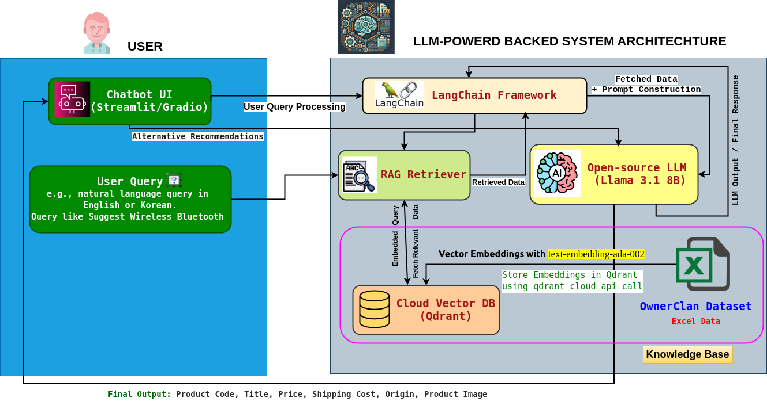
Updated System Configuration (AI Model) Diagram
3

Slide 5
Project Schedule (Gantt Chart)
Phase | 2025
 | March |  |  |  | April |  |  |  | May |  |  |  | June
 | 1 | 2 | 3 | 4 | 1 | 2 | 3 | 4 | 1 | 2 | 3 | 4 | 1 | 2
Project Understanding and Data Collection
Data Analysis and Pre-processing
Model Selection and Training
System Development
Chatbot UI Development
Testing and Deployment
4

Slide 6
Previous Communication with company
Questions:
Looking at the core technology stack you sent me, it uses FAISS as a vector search library, but is it okay to use something else?
Contents of the answer
In addition to FAISS (vector search library), you may use vectorDB or other vector search libraries.
5

Slide 7
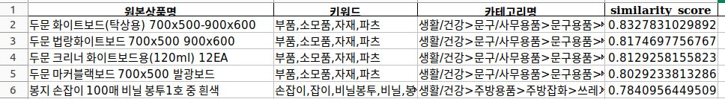
Example of Previous Embeddings Output in our system
all-MiniLM-L6-v2 and intfloat/e5-small-v2 results on Korean dataset
Query output from this embedding most of the time provides incorrect results.
intfloat/multilingual-e5-large results on Korean dataset
Original Query: 화이트보드​
Translated to English: White board
Sometimes provide incorrect results that means the embedding is not perfect.
6

Slide 8
Best embedding model selection (on OwnerClan KR Dataset)
Embedding Model Comparison Table
Model Name | Multilingual Support | Performance (Korean Data) | Vector Size | API Cost | Comments
🟢 text-embedding-ada-002 (OpenAI) | ✅ Strong | ⭐ Best (High Recall & Precision) | 1536 | 💵 $0.0001 per 1K tokens | - High-quality multilingual support - Long input support - Robust API' - Paid API (billing required) - Requires OpenAI API key
🔵 intfloat/multilingual-e5-large | ✅ Yes | ✅ Good ( ⚠️especially with product titles) | 1024 | Free (HuggingFace) | - Good performance - Slower loading - Needs preprocessing - Easy to test offline
🔵 intfloat/e5-small-v2 | ✅ Yes | ⚠️ Mediocre on this dataset | 384 | Free (HuggingFace) | - Lightweight - Slower loading on Korean dataset
🔵 LaBSE (sentence-transformers) | ✅ Yes | ⚠️ Poor performance in this dataset | 768 | Free | - Designed for multilingual tasks. - Outdated architecture - Lower quality embeddings
🔵 all-MiniLM-L6-v2 (ST) | ⚠️ Limited (mainly English) | ❌ Worst performer | 384 | Free | - Fast and small - Poor Korean support - Not trained for your use case
As the company suggested, I achieved optimal performance, so I chose the paid model: text-embedding-ada-002 (OpenAI).
7

Slide 9
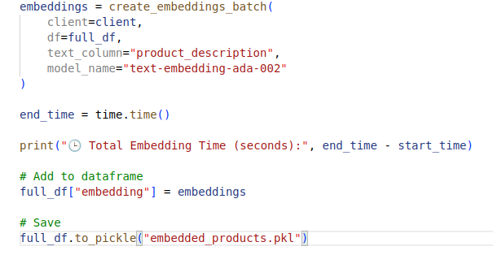
'text-embedding-ada-002' embedding model in our system
I selected only the meaningful relevant columns: 원본상품명 (Product Name), 키워드 (Keywords), 모델명 (Model Name).
As 키워드 (Keywords) contains most of the important terms of a product, so I think, 카테고리명 (Category), 정보고시 항목정보(Product_Info_Details) is unnecessary and redundant.
Apply Preprocessing such as lowercase (important for multilingual compatibility) , clean extra whitespace, clean up excessive commas, keep Korean, English, numbers, basic punctuation.
# Select Relevant Column: 원본상품명 (Product Name), 키워드 (Keywords), 모델명 (Model Name)
df = df[['원본상품명', '키워드', '모델명']]
# Lowercase (important for multilingual compatibility)
def generate_processed_text(row):
return (
f"passage: "
f"[product title] {str(row['원본상품명']).strip()} "
f"[keywords] {str(row['키워드']).strip()} "
f"[model name] {str(row['모델명']).strip()}"
).lower()
# -------------------- Apply Preprocessing --------------------
df["product_description"] = df.apply(generate_processed_text, axis=1)
# Clean extra whitespace
df["product_description"] = df["product_description"].str.replace(r"\s+", " ", regex=True).str.strip()
# Clean up excessive commas
df["product_description"] = df["product_description"].str.replace(r",+", ",", regex=True)
# Keep Korean, English, numbers, basic punctuation
df["product_description"] = df["product_description"].apply(
lambda x: re.sub(r"[^\uAC00-\uD7A3a-zA-Z0-9\s,./:()\[\]<>-]", "", x) )
🕒 Total Embedding Time (seconds): 3828.4740250110626
Total Embedding Time: ~63.81 minutes (about 1 hour and 4 minutes)
8

Slide 10
Vector data store selection (on OwnerClan KR Dataset)
Vector DB Comparison
Feature | 🟢 Qdrant (Best Fit) | 🔵 Milvus | ⚪ FAISS
Setup & Integration | ✅ Easy Python API, no Docker | ❌ Docker/K8s required | ✅ Simple but manual setup
Metadata Support | ✅ Flexible JSON metadata | ⚠️ Fixed schema | ❌ Not supported
Multilingual Ready | ✅ Yes (KR, EN, JP) | ✅ Yes | ✅ Yes ( ⚠️ not directly)
Resource Needs | ✅ Lightweight, no GPU needed | ❌ Heavy (GPU/server recommended) | ✅ Lightweight
Chatbot Compatibility | ✅ Works well with RAG/chatbot | ⚠️ Needs workaround | ❌ Not RAG-friendly
Managed Cloud Option | ✅ Qdrant Cloud available | ❌ Manual hosting only | ❌ Local only
Pricing | ✅ Generous free tier, managed API | ❌ No free tier | ✅ Free, but limited
Best For | ✅ Product search, fast POC | 🔄 Enterprise-level ML systems | ⚠️ Only simple vector search
I selected Qdrant for its free cloud tier via API call and JSON style metadata.
9

Slide 11
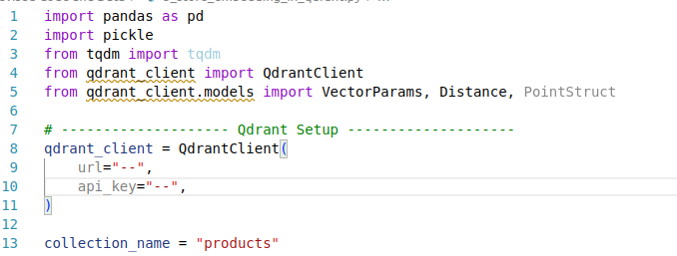
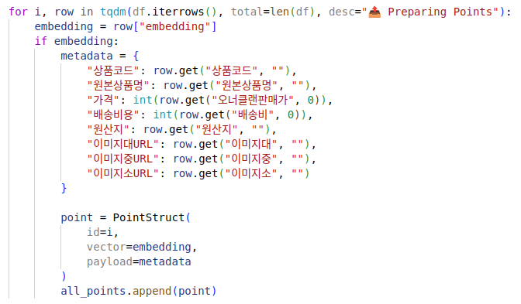
Qdrant Vector DB in our system (Embedded Dataset)
1
2
def save_embeddings_to_file(embeddings, output_path="product_embeddings_with_metadata.pkl"):
with open(output_path, 'wb') as f:
pickle.dump(embeddings, f)
print(f"✅ Embeddings saved locally to '{output_path}'")
# Upload
store_embeddings_in_qdrant(qdrant_client, collection_name, df, batch_size=200)
# Extract embeddings
embeddings = df["embedding"].tolist()
# Save to local file
save_embeddings_to_file(embeddings)
3
10

Slide 12
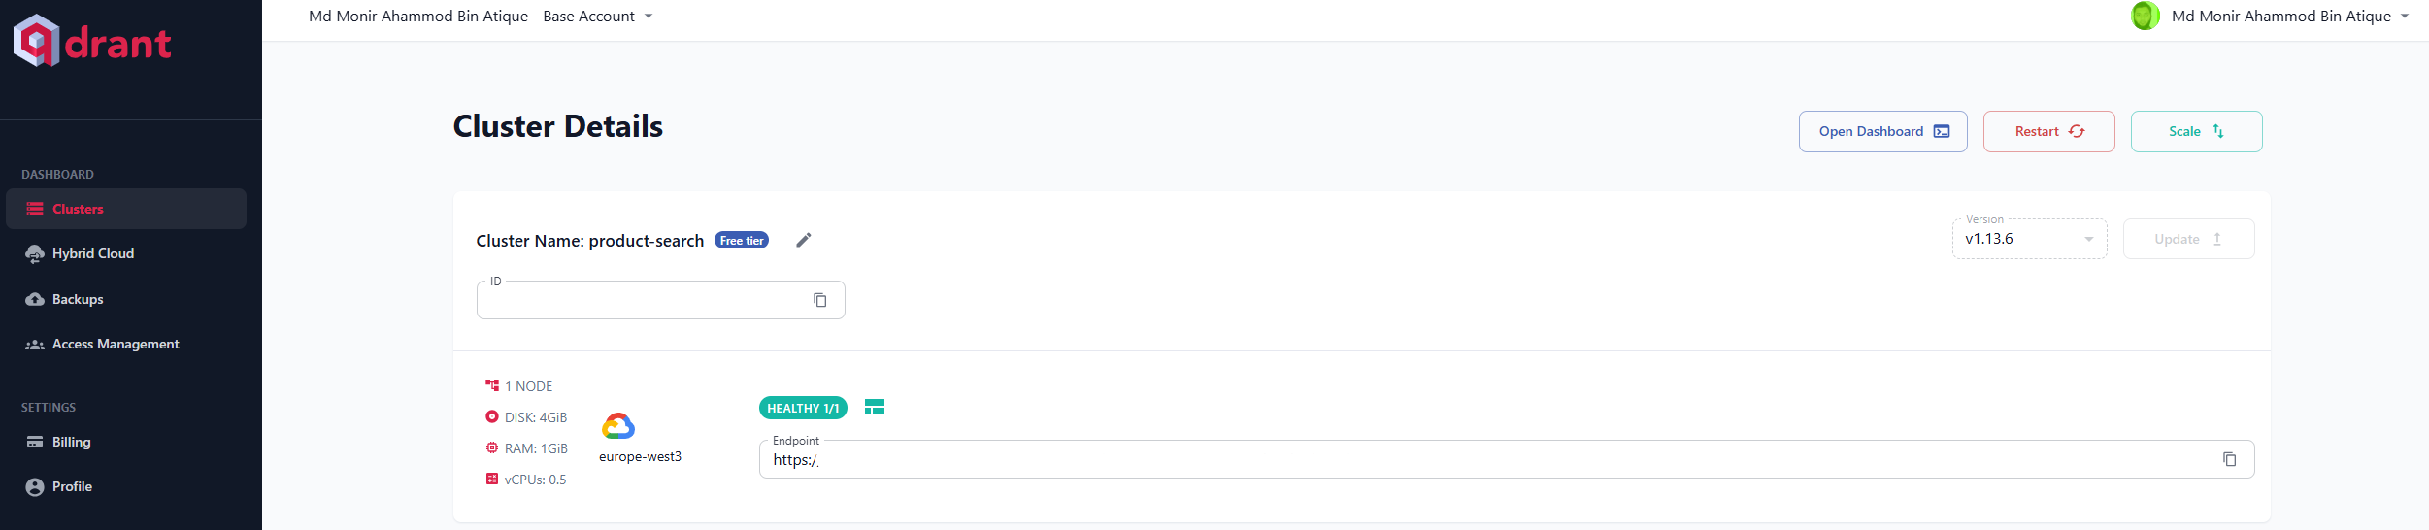
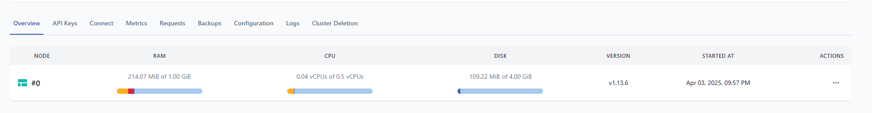
Qdrant Cloud
Qdrant Cloud: creating cluster
Qdrant Cloud: storing embedding on cloud cluster
11

Slide 13
Next Tasks To Do
Next Step
LangChain Framework study.
Plan to integrate our embedding and vector DB with LangChain.
12

Slide 14
Thank You for Listening
13

